Slide 1
ESC GRANTEE SELECTION PROCESS
SEPTEMBER 24, 2024
10:00 AM

Slide 2
Selection of ESC Grantees
Elementary graduate from a public or DepEd-recognized elementary school.
Incoming Grade 7 Student (ALS A&E/PEPT Grade 7 Qualifiers are included)
Has not been a recipient of the ESC in the previous school years.
Filipino citizen.

Slide 3
ESC Application Requirements
Two (2) pcs. latest 2×2 picture. Students must wear decent attire, and be on a white background. ..
Copy of Grade 6 Report Card.
PSA Birth Certificate
Latest Income Tax Return for the previous year or Certificate of Tax Exemption or Municipal Certification of Unemployment of Parents/Legal Guardian or any Proof of Income (We will accept Certification issued from the Barangay( BOTH PARENTS )
ESC Grantee Enrolment Contract
Date Privacy notice
Note: Requirements must all be in hard copy to be submitted in a long white folder to the Registrar's Office.

Slide 4
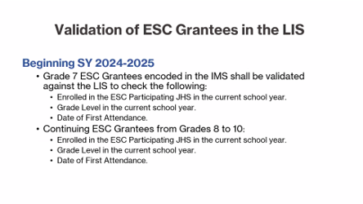

Slide 5
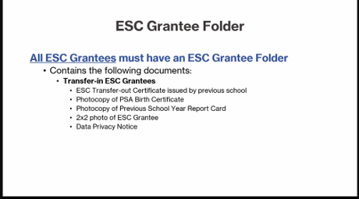

Slide 6

RESOURCES

Slide 7
Thank you

